Slide 1
How can we
Manage Performance
in Regulatory Affairs?
Katlego Ramorola

Slide 2
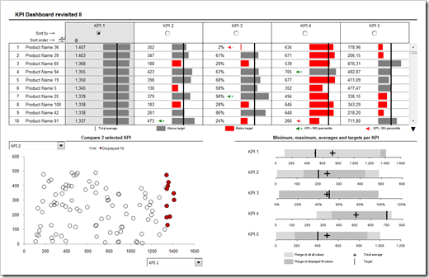

Slide 3
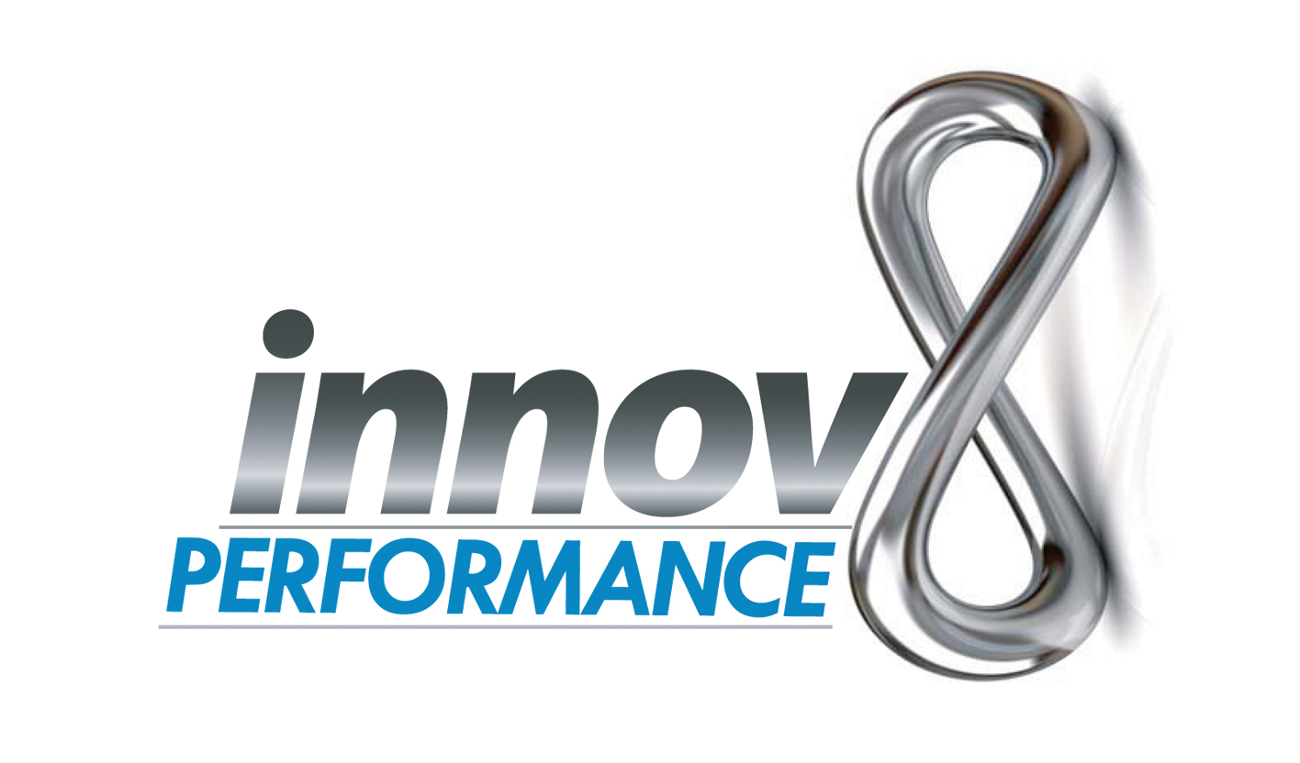
Performance management
through innovative solutions

Slide 4
Reality:
Performance Management is never done correctly
Employees and Managers both HATE appraisal time!
Most companies resort to EXCEL, paper based solutions or guess work
Because TIME MANAGEMENT never works!!

Slide 5
Is Customisable to you
Imagine 24/7 365 days of performance awareness?
Removes BIAS

Slide 6
Customisation 4U
IPA’s/ KPA’s/ KPI’s usually use balanced scorecard platforms
Innov8 Performance uses a Points Based System (PBS) that ‘talks’ to your Balanced Score Card(BSC)
OR even any measures you currently use

Slide 7
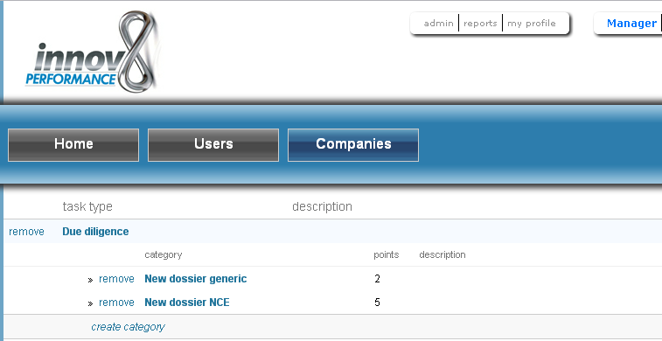
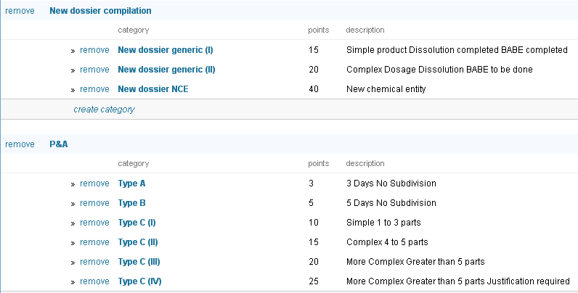

Slide 8
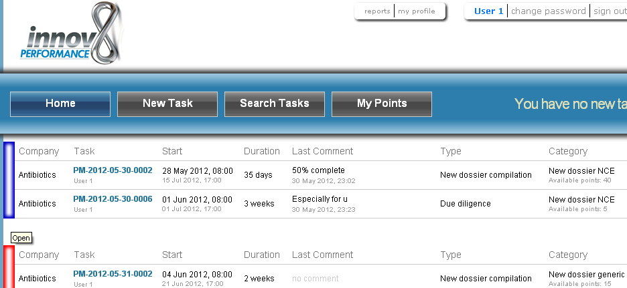

Slide 9
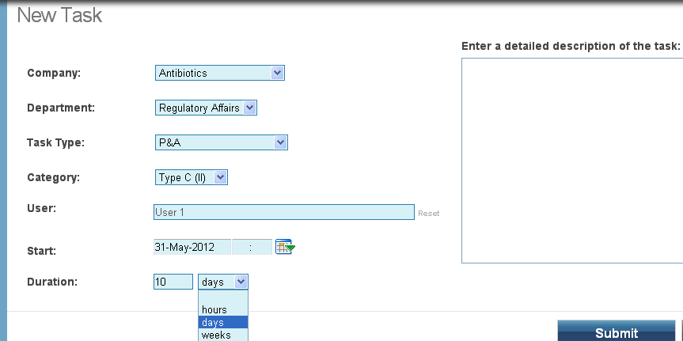

Slide 10
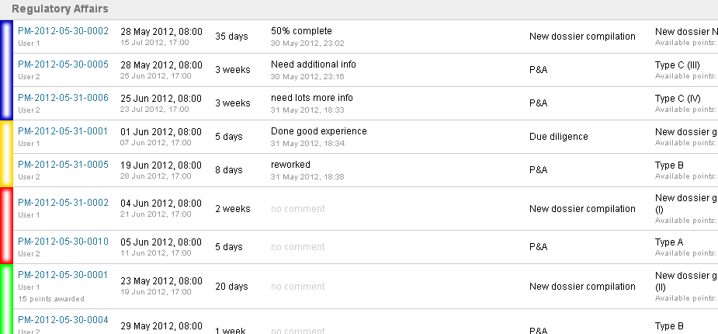

Slide 11
Aligned with your HR processes
Making performance quantifiable
Removing bias
Continuous Improvement
Features & Benefits

Slide 12
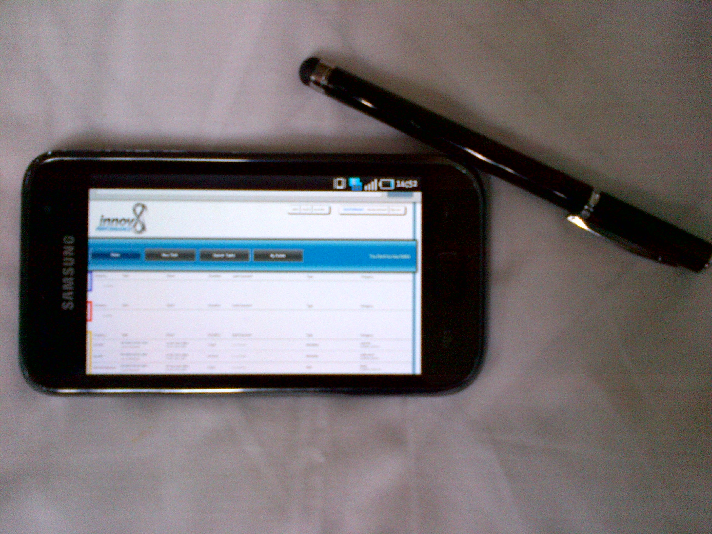
What else does it do?
Constant access to draw daily/ monthly yearly reports on just about anything!
YOUR weighting YOUR targets
No, Surprise, U didn't perform!

Slide 13
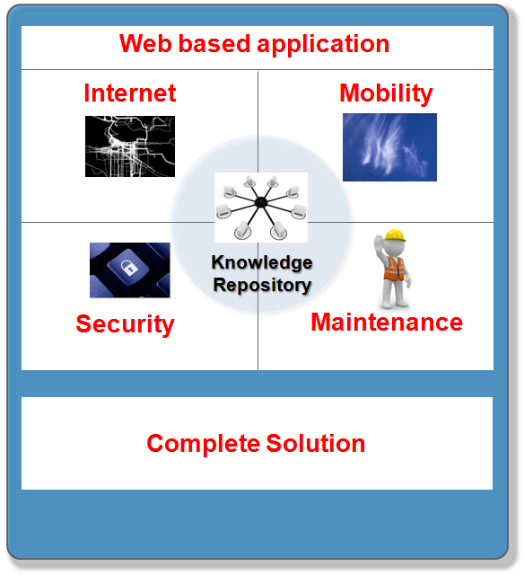
Technology Overview
Model 1
Model 2
Cloud based
Platform
Locally
hosted
Infrastructure
Infrastructure
Scalable Hardware
Platform
Hardware
Platform
Data
Communication
Hosting
Data
Communication
Product Lifecycle Mgmt
Product
Lifecycle Mgmt

Slide 14
Performance Flux
Engagement
Development
Results
Comprehensive Approach
Assessment
Constant awareness of performance rating
Leading performance
Accurate performance assessments
Output
Constant awareness of team outputs
Competitive edge
Task/output allocation 24/7
Self managing opportunity for employees (competitive platform)
Daily assessment opportunities
Daily/ Monthly/ Yearly reports
Agreed targets
Output tracking
Target reflection and adjustment (if necessary)
Unbiased!
Performance transition
Your Development

Slide 15
Performance appraisal becomes all about YOUR DEVELOPMENT

Slide 16
Thank you
Q&A

