Slide 1
Diabetes: Focus on New therapies
Dr Poobalan Naidoo
BPharm MBBCh MMedSc (Pharmacology) FCP(SA) part 1
Medical Advisor
Boehringer Ingelheim, South Africa
2014

Slide 2
Disclaimers
Funding for IIS: Sandoz
Consultant for Abbot Pharmaceuticals
Medical advisor: Boehringer Ingelheim
Senior Research Officer, UCT, Department of Medicine, Clinical Pharmacology

Slide 3
Outline of the presentation
Type 2 Diabetes: epidemiology & consequences
Current therapies
New therapy: a mechanism for direct glucose removal
New drug classes in Research and Development
Take home message
Notes:
Glucose is a vital fuel for the human body(Wright et al., 2007) yet the body must defend itself from both hyperglycaemia and hypoglycaemia, both of which can have serious consequences. Hyperglycaemia is associated with acute conditions (diabetic ketoacidosis and hyperosmolar hyperglycaemic state) and chronic complications (including retinopathy, neuropathy, nephropathy and premature atherosclerosis). On the other hand hypoglycaemia can cause cardiac arrhythmias, neurological dysfunction, coma, seizures and death.(Gerich, 2010)
In health, blood glucose levels are therefore maintained within narrow concentration limits. Maximum blood concentrations following meal ingestion are usually <9.0 mmol/L and minimum concentrations, after a moderate fast or exercise, are usually >3.0 mmol/L. This is in contrast to other substrates such as glycerol, lactate, free fatty acids and ketone bodies, for which daily fluctuation is much greater. (Gerich, 2010)
Blood glucose concentrations are determined by the relative rates of glucose entry into, and removal from, the circulation.(Gerich, 2010) Glucose homeostasis is modulated by a complex interplay of factors such as fuel availability, physical activity, hormones, lipids and glucose transporters.(Gerich, 2010)

Slide 4
Type 2 Diabetes – epidemiology & consequences

Slide 5
Every 10 seconds... Two people develop diabetes
The number of patients with diabetes worldwide is expected to increase from 366 million in 2011 to 552 million in 2030
Number of patients, millions
2011
2030
North America and Caribbean
South and Central America
Europe
Africa
India
China
Others
International Diabetes Federation. IDF Homepage. International Diabetes Federation 2011. Available from: http://www.idf.org/.

Slide 6
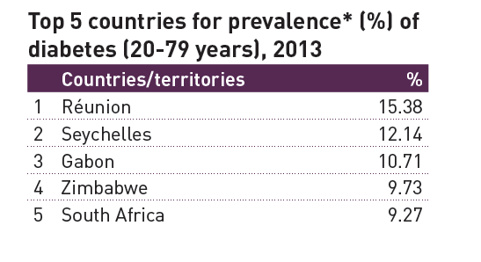
Prevalence of Diabetes

Slide 7
Diabetes in South Africa
In South Africa, the prevalence is 9.2% in 20-79 year age group, accounting for approximately 2.6 million cases (IDF, 2013).
Projection for 2035 is 3.94 million
Currently, the number of annual diabetes related deaths in SA: 83 000
1. International Diabetes Federation. Diabetes Atlas, Fifth Edition: www.diabetesatlas.org. Accessed end 2013.

Slide 8
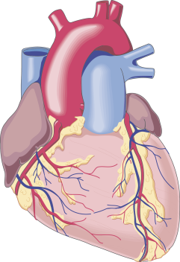
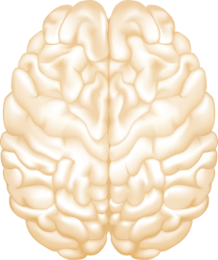
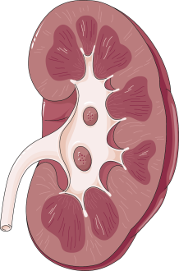
Every 10 seconds, one person dies from diabetes-related complications¹
Diabetes significantly increases the risk of
Heart disease by 2–4 fold²
Stroke
by more than 2–4 fold²
In the next 24 hours, 17,280 patients will develop diabetes… in USA
62 new patients will have severe vision loss due to diabetes²
137 new patients will need dialysis²
186 new patients will have an amputation²
1. International Diabetes Federation. Diabetes Atlas, Fifth Edition: www.diabetesatlas.org. Accessed 25 June 2012. Estimated based on mortality data; 2. Adapted from: CDC 2011 National Diabetes Fact Sheet: http://www.cdc.gov/diabetes/pubs/estimates11.htm#12. Accessed June 2011.
Notes:
Every 10 seconds a patient with diabetes dies from related complications. Diabetes is associated with numerous complications which can affect different organ systems throughout the body. Diabetic retinopathy is a leading cause of blindness, and affects 4.2 million people with diabetes in the US. Diabetic kidney damage is still the leading cause for renal end-stage disease and need for dialysis. Diabetic neuropathy is a leading cause of foot wounds and ulcers, often leading to leg and foot amputations. In 2006, in the US alone, 65,700 amputations were required in diabetes patients. 4.6 millions deaths a year are related to diabetes-related causes on a global basis. This means that approximately 13,0680 people die every day.

Slide 9
The majority of patients in USA with T2D remain far above glycaemic goals
10.1% have HbA_{1c} >10%²
10.0
9.0
20.2% have HbA_{1c} >9%¹
37.2% have HbA_{1c} >8%¹
8.0
47.8% of patients
with T2D
have HbA_{1c} >7.0%^{1*}
7.0
ADA/EASD target (<7%)^{3,4}
6.0
HbA_{1c}
*Adapted from Saydah SH, et al. JAMA. 2004;291:335–342.
1. Dodd AH, et al. Curr Med Res Opin. 2000;291:1605–1613; 2. Oluwatowoju I, et al. Diabet Med. 2010;27:354–359; 3. ADA. Diabetes Care. 2013;36:S11–S66; 4. Inzucchi SE, et al. Diabetes Care. 2012;35:1364–1379;
Notes:
Many patients with T2D remain above glycaemic targets. Indicated on this slide are the current glycaemic targets – the ADA recommend that HbA_{1c} levels should be controlled below 7%. The AACE and ACE jointly recommend a tighter target of HbA_{1c} below 6.5%. Despite these targets and current treatments, the majority of patients with diabetes still have an HbA_{1c} above 7.0%. Almost 40% of patients with T2D have an HbA_{1c} above 8%, and many have HbA_{1c} even higher still, above 9% and 10%.The prevalence of uncontrolled diabetes, despite the available medications, is a major issue.

Slide 10
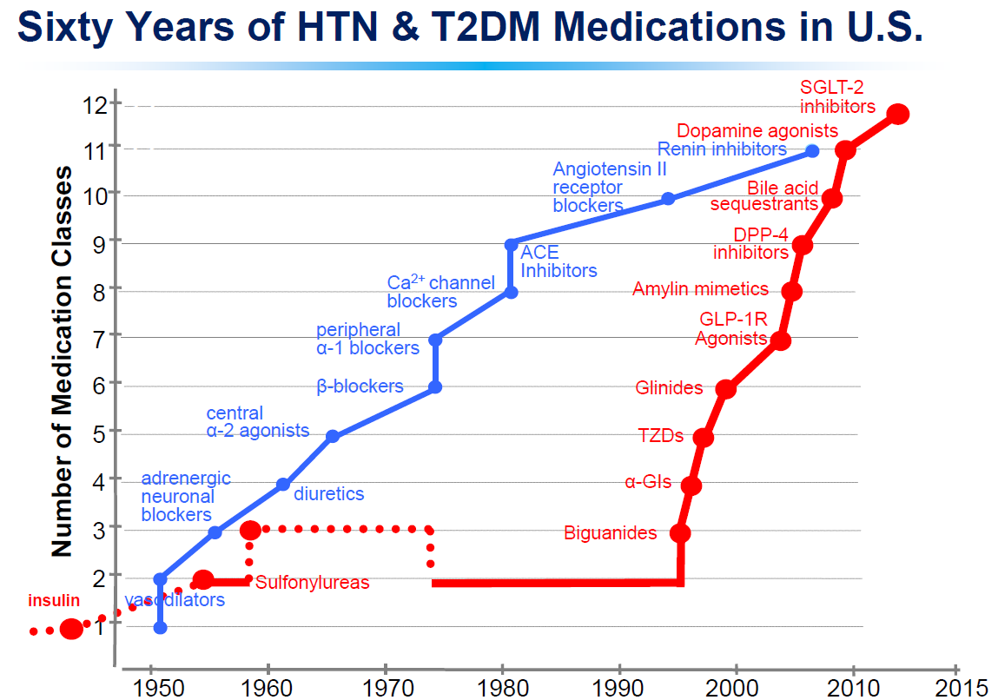
Development of Anti-diabetics Agents

Slide 11
Class | Example | Mechanism of action | HbA1C | Limitations
Biguanides | Metformin | (-) hepatic glucose production (-) insulin resistance | 1-1.5% | GIT disturbances
SUs | Gliclazide, glibenclamide, glipizide, glimiperide | (+) insulin secretion | 1-1.5% | Weight gain Hypoglycaemia Limited durability Cardiovascular profile contentious
Thiazolidinediones (TZDs) | Pioglitazone, rosiglitazone | (-) insulin resistance | 1-1.5% | Fluid retention Weight gain Heart failure
DPP-4 inhibitors | Sitagliptin, saxagliptin, linagliptin, alogliptin, vildagliptin | (+) incretin levels (+) insulin (-) glucagon | 0.7-0.8% | Limited HbA1c reduction
GLP-1 receptor agonists | Exendatide, liraglutide, albiglutide, dulaglutide | (+) insulin (-) glucagon (-) gastric emptying (+) satiety | 1-1.5% | Nausea Injection Cost

Slide 12
Less commonly used/not all registered is SA
Class | Example | Mechanism of action | HbA1C | Limitations
Meglitinides | Repaglinide Nateglinide | (+) insulin secretion | 1-1.5% | Hypoglycaemia
Alpha-glucosidase inhibitors | Acarbose, miglitol, voglibose | (-) carbohydrate absorption | 1-1.5% | GIT disturbances
Amylinomimetics | Pramlintide | (-) glucagon (-) gastric emptying (-) appetite | 1-1.5% | Injection Costly
Dopamine agonists | Bromocriptine | (+) insulin sensitivity | 0.7-0.8% | Syncope Nausea
Bile acid sequestrants | Colesevelam | (-) hepatic glucose production | 1-1.5% | GIT disturbances

Slide 13
Current therapy has limitations Remains unmet needs and requirement for new therapies

Slide 14
Glucose homeostasis: it’s more than just β-cell function

Slide 15
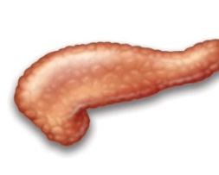
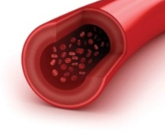
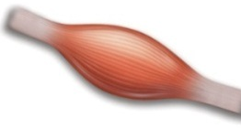
T2D is a dysregulation of glucose homeostasis characterized by persistent hyperglycaemia, impaired β-cell function and insulin resistance
Impaired β-cell function
Type 2 Diabetes
Persistent hyperglycaemia
Insulin resistance
DeFronzo RA. Diabetes. 2009;58:773–795; Poitout V, Robertson RP. Endocrinology. 2002;143:339–342; Robertson RP, et al. Diabetes. 2003;52:581–587.
Notes:
T2D is a dysregulation of glucose homeostasis characterized by persistent hyperglycaemia, impaired β‐cell function and insulin resistance.
These 3 factors are interrelated, and form a ‘vicious cycle’ whereby they feed into one another.
All 3 of these defects tend to increase over time; hence there is a progressive rise in blood glucose levels, coupled with increasing insulin resistance and decreasing β‐cell function.

Slide 16
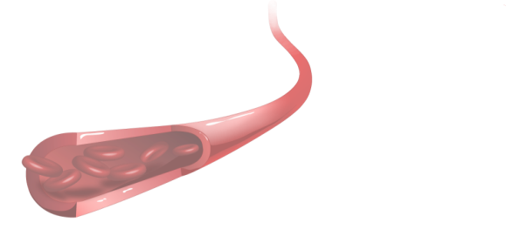
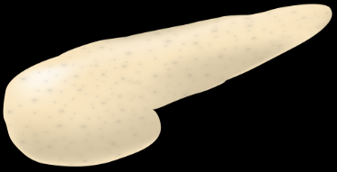
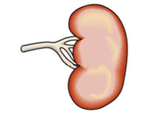
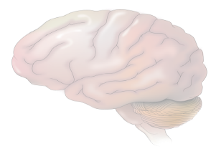
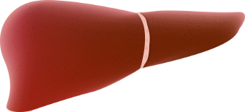
From the triumvirate to the ominous octet
Decreased insulin secretion
Decreased incretin effect
Increased lipolysis
Islet α-cell
Hyperglycaemia
Increased glucose re-absorption
Increased glucagon secretion
Decreased glucose uptake
Increased hepatic glucose production
Neurotransmitter dysfunction
DeFronzo RA. Diabetes. 2009;58:773–795.
Notes:
Although the centrality of hyperglycaemia, impaired β‐cell function and insulin resistance is undebated, the list of pathological derangement has expanded in recent years from a triad, to become an ‘ominous octet’. In short, in addition to the muscle, β‐cell and liver dysfunction discussed above, the fat cell (accelerated lipolysis), gastrointestinal tract (incretin resistance), α‐cell (hyperglucagonaemia), kidney (increased glucose reabsorption) and brain (insulin resistance) can all play important roles in the development of glucose intolerance in Type 2 diabetic individuals. Collectively, these eight factors comprise the ominous octet.
Please keep in mind when dicsussing the “octet”. The increase in glucose reabsorption, due to upregulation of SGLT2 is surely not one of the major players in this octet leading to Hyperglycemia but surely play a certain role. The MOA of SGLT2-inhibition is supra-physiological and is not a correction of something which is pathophysiological disturbed in Type 2

Slide 17
Kidney and Glucose Homeostasis

Slide 18
Renal glucose filtration and re-absorption

Slide 19
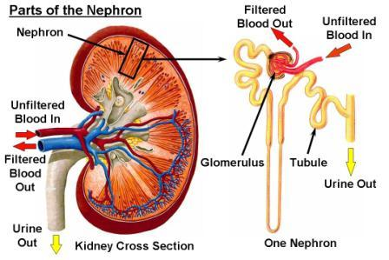
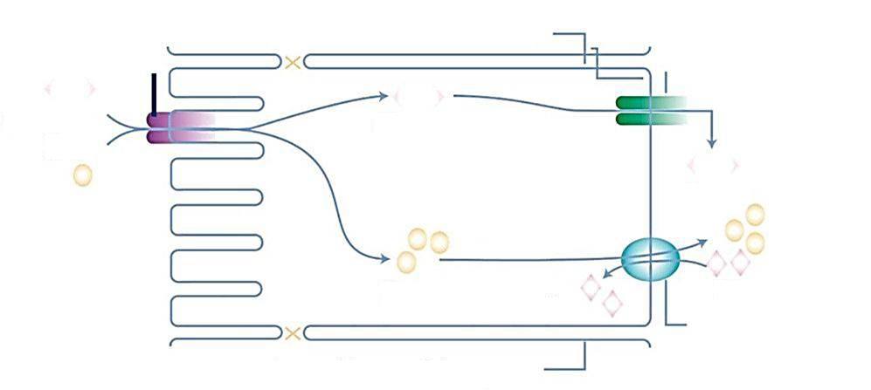
Transport of glucose against a concentration gradient^{1,2}
Segment S1–2
Basolateral membrane
SGLT2
GLUT2
Glucose Na⁺
Glucose
Glucose Na⁺
Na⁺
K⁺
K⁺
Na⁺/K⁺ATPase pump
Lateral intercellular space
Glucose
1. Wright EM, et al. Physiology. 2004;19:370–376.
2. Bakris GI, et al. Kidney Int. 2009;75:1272–1277.
Notes:
The process involves (DeFronzo et al., 2012, Mather and Pollock, 2010) :
An adenosine triphosphatase (ATPase)-mediated sodium-potassium pump located on the basolateral border of the cell pumps sodium into the circulation
2. This reduces the intracellular concentration of sodium relative to the lumen, thereby generating an electrochemical concentration gradient of sodium ions across the luminal cell membrane (Mather and Pollock, 2010)
3. The electrochemical concentration gradient of sodium is coupled with, and drives, SGLT-mediated active transport of glucose from lumen into the cell (Mather and Pollock, 2010) - Na+:glucose coupling ratio for SGLT2 = 1:1, increasing the intracellular glucose concentration
4. Glucose is then passively transported via GLUT from inside the cell into the bloodstream down a glucose concentration gradient
DeFronzo, R. A. et al. 2012. Diabetes Obes Metab, 14, 5-14.
Mather, A. & Pollock, C. 2010. Nat Rev Nephrol, 6, 307-11.

Slide 20
Renal glucose re-absorption in healthy individuals
Filtered glucose load 180 g/day
SGLT2
~ 90%
SGLT1
~ 10%
Gerich JE. Diabet Med. 2010;27:136–142.
Notes:
In healthy subjects, in the kidney, the amount of glucose re-absorbed through the SGLT1 and SGLT2 transporters is equal to the amount of glucose that is filtered by the glomerulus. Glucose re-absorption by the proximal tubule increases linearly with increasing glucose concentration, up to a theoretical threshold of ~ 180 mg/dL.
The SGLT2 transporter mediates 90% of renal glucose re-absorption by coupling glucose transport to the electrochemical sodium gradient. The other 10% of renal glucose re-absorption occurs through SGLT1, a high-affinity, low-capacity transport protein that is found in the more distal, straight section of the proximal tubule (S3), where there is less luminal glucose.
Recent studies suggest that in subjects with low blood glucose, SGLT1 is responsible for a higher percentage of renal re-absorption.

Slide 21
Renal glucose re-absorption in patients with hyperglycaemia
Filtered glucose load > 180 g/day
SGLT2
When blood glucose increases above the renal threshold (~ 10 mmol/l or 180 mg/dL), the capacity of the transporters is exceeded, resulting in urinary glucose excretion
~ 90%
SGLT1
~ 10%
Gerich JE. Diabet Med. 2010;27:136–142.
Notes:
At a certain glucose concentration the glucose flux is to high and the glucose transport system becomes saturated . All the filtered glucose in excess of this threshold is excreted In the urine.
DeFronZo EASD 2012 abstract:
Dapagliflozin reduces renal threshold for glucose excretion in T2D
R.A. DeFronzo1, M. Hompesch2, S. Kasichayanula3, X. Liu3, Y. Hong3, M. Pfister3, L.A. Morrow2,
B.R. Leslie3, D.W. Boulton4, A. Ching3, F.P. LaCreta3, S.C. Griffen3;
1
University of Texas Health Science Center, San Antonio, 2Profil Institute for Clinical Research,
Chula Vista, 3Bristol-Myers Squibb, Princeton, 4Bristol-Myer Squibb, Princeton, USA.
Background and aims: Dapagliflozin is a selective sodium-glucose co-transporter 2 (SGLT2)
inhibitor that reduces hyperglycaemia in T2D by promoting urinary glucose excretion. This
study examined the effect of dapagliflozin on renal glucose kinetics in healthy subjects and subjects
with T2D.
Materials and methods: Renal glucose kinetics were assessed in 12 healthy control subjects (HbA_{1c}
5.5 %, 41 years, 27 kg/m², 7 male/5 female) and 12 subjects with T2D (HbA_{1c} 6.5%, 53
years, 30 kg/m², 7 male/5 female). All subjects had an estimated glomerular filtration rate (eGFR) ≥
60 and ≤ 160 mL/min∙1.73 m² by the Modification of Diet in Renal Disease equation. Subjects
underwent a combined pancreatic and stepped hyperglycaemic clamp at baseline and after 7 days of
dapagliflozin 10 mg/day. The pancreatic/stepped hyperglycaemic clamp was performed with
octreotide and basal insulin/glucagon/growth hormone replacement, and evaluated a plasma glucose
range of 100-550 mg/dL. Subjects with T2D continued on baseline therapy unless taking
metformin, which was held for 48 h before the pancreatic stepped hyperglycaemic clamp. A model
was developed to describe maximum tubular glucose transport (TmG), renal glucose threshold (for
onset of glucosuria), and splay of the glucose titration curve for healthy and T2D
populations, and then used to estimate these parameters from individual titration curves.
Results: At baseline, the TmG (443 vs 326 mg/min, p < 0.04) and splay (28,650 vs 14,248 mg2/min2,
p < 0.0001) were significantly higher in subjects with T2D vs controls. The baseline
threshold was similar in subjects with T2D (196 mg/dL [10.9 mmol/L]) and controls (171
mg/dL [9.5 mmol/L]). Dapagliflozin treatment reduced TmG by 58% in T2D subjects and
53% in healthy subjects. The splay declined similarly by ~ 37% for both groups. Following
dapagliflozin, the modelled threshold was markedly reduced in T2D patients, by 89% (21
mg/dL [1.2 mmol/L]) and in healthy controls, by 78% (37 mg/dL [2.1 mmol/L]). These modelled
threshold values were well below the plasma glucose levels measured in this study. A modest
reduction in GFR (~ 14%) was observed following dapagliflozin treatment in both groups.
Conclusion: In summary, T2D subjects have a higher TmG and splay than healthy
controls. Dapagliflozin treatment for 7 days reduced TmG and splay. However, the markedly
decreased renal glucose threshold was the primary mechanism responsible for the induction of
glucosuria with dapagliflozin in both subjects with T2D and healthy controls.
Clinical Trial Registration Number: NCT01165268
Supported by: AstraZeneca and Bristol-Myers Squibb

Slide 22
SGLT2 inhibition: a mechanism for direct glucose removal

Slide 23
Urinary glucose excretion via SGLT2 inhibition
Filtered glucose load > 180 g/day
SGLT2 inhibitors reduce glucose re-absorption in the proximal tubule, leading to urinary glucose excretion* and osmotic diuresis
SGLT2 inhibitor
SGLT2
SGLT1
*Loss of ~ 80 g of glucose/day (~ 240 cal/day).
Gerich JE. Diabet Med. 2010;27:136–142.
Notes:
SGLT2 inhibition lowers the Tm – the maximum re-absorptive capacity of the proximal tubule and lower the renal threshold for Glucose. Therefore, treated subjects will start to renally excrete glucose. The amount of excreted glucose is dependent on the Glucose filtration and therefore dependent on the blood glucose values. In the hypoglycaemic Range the amount of Glucose which is excreted will be very small and with rising blood Glucose the excreted glucose will also increase. Subjects with high baseline glucose will have a much higher glucose excretion rate than subjects which are near normal. In the PK/PD studies a UGE (urinary glucose excretion) of around 80 g/day was measured. The Glucose loss is associated with fluid loss (increase in urine volume), osmotic diuresis and of with caloric loss. (average of 240 cal/day)

Slide 24
SGLT2 inhibition

Slide 25
New Drugs in Type 2 diabetes

Slide 26
SGLT inhibitors
Phlorizin (1933):
extracted from bark of apple trees
glucose ring connected to 2 phenol rings via oxygen
inhibits both SGLT1 and SGLT2
More recent SGLT2 inhibitors:
Sergliflozin
Remogliflozin Development stopped
Dapagliflozin
Canagliflozin Registered in EU and US
Empagliflozin
Abdul-Ghani M et al Curr Diab Rep 2012; 12: 230-238

Slide 27
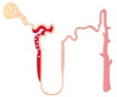
SGLT2 inhibition lowers glycaemia independently of β-cell function and insulin resistance^{1–4}
Impaired β-cell function
SGLT2 inhibition directly targets glucose via urinary glucose excretion
Persistent hyperglycaemia
Persistent hyperglycaemia
Insulin resistance
1. DeFronzo RA. Diabetes. 2009;58:773–795.
2. Poitout V, Robertson RP. Endocrinology. 2002;143:339–342. 3. Robertson RP, et al. Diabetes. 2003;52:581–587.
4. DeFronzo RA. Diabetes Obes Metab. 2012;14:5–14.
Notes:
Unlike many current therapies, the mechanism of action of SGLT2 inhibition is independent of insulin secretion or insulin resistance. SGLT2 inhibition removes glucose directly.

Slide 28
Summary
SGLT2 is responsible for ~ 90% of the total renal glucose re-absorption
SGLT2 inhibition induces urinary glucose excretion, resulting in a reduction of blood glucose

Slide 29
SGLT2 inhibitors: known or in development

Slide 30
Characteristics of SGLT2 inhibitors in advanced development or launched
 |  | Empagliflozin¹ | Dapagliflozin² | Canagliflozin³
 | Launch year | 2014(EU/US) | 2012 (EU) 2014 (US) | 2013 (EU/US)
MoA | Molecular class | C-glycoside | C-glycoside | C-glycoside
 | Metabolism | Dual renal and hepatic 50:50 | Mainly hepatic 97:3 | Mainly hepatic, no details reported
Dosing | Administration | Oral | Oral | Oral
 | Regimen | Once daily | Once daily | Once daily
 | Doses | 10 mg and 25 mg | 5 mg and 10 mg | 100 mg and 300 mg
Competitor analysis
1. Data on file; 2. Dapagliflozin SMPC; 3. Canagliflozin SMPC.

Slide 31
PK/PD characteristics of empagliflozin, dapagliflozin and canagliflozin (1/2)
 |  | Empagliflozin¹ | Dapagliflozin²⁻⁴ | Canagliflozin⁵⁻⁷
PD | Clinical doses in Phase III | 10–25 mg | 5–10 mg | 100–300 mg
 | Selectivity over SGLT1 | >1:2500 | 1:1200 | 1:414
 | Glucose excretion | 70–90 g/day | 18–62 g/day | ~70 g/day
 | Duration of action | T_{½}: 10–19h | T_{½}: 17h | T½: 12–15 h
PK | Absorption | Rapid; peak levels 1.5 h after dosing | Rapid; peak levels 1.5 h after dosing | Peak levels 2.75 h (300 mg) to 4 h (100 mg) after dosing
 | Distribution | Moderate volume of distribution; GI tract, urine and bile Not measurable in the central nervous system | Modest extravascular distribution with a volume ranging from total body water in the dog and monkey to ~2-fold total body water in the rat | Extensive tissue distribution, extensively bound to proteins in plasma (99%)
Competitor analysis
1. Thomas L, et al. Diabetes Obes Metab. 2012;14:94–96; 2. Komoroski B, et al. Clin Pharmacol Ther. 2009;85:520–526; 3. Komoroski B, et al. Clin Pharmacol Ther. 2009;85:513–519; 4. Obermeier MT, et al. Drug Metab Dis. 2010;38:405–414; 5. Schwartz SS, et al. Diabetes. 2010;59 (Suppl 1)(Abstract 564-P); 6. Sha S, et al. Diabetes Obes Metab. 2011;13:669–672; 7. Nomura S, et al. J Med Chem. 2010;53:6355–6360.

Slide 32
Class Benefits vs Risks
Benefits | Risks/Limitations
Oral Once daily administration MOA independent of beta cell function and insulin resistance Beyond HbA1c Weight reduction Blood pressure reduction | eGFR > 45-60 ml/min UTIs/GTIs New class with limited real world data (await CVOT data)

Slide 33
Pharmacotherapy for diabetes in 2025?
Inhibitors of 11β-hydroxysteroid dehydrogenase 1, which reduce the glucocorticoid effects in liver and fat
Insulin-releasing glucokinase activators and pancreatic-G-protein-coupled fatty-acid-receptor agonists
Glucagon-receptor antagonists
Metabolic inhibitors of hepatic glucose output are being assessed

Slide 34
Take home messages
Type 2 Diabetes is increasing
Currently glycaemic control is sub-optimal
SGLT-2 inhibitors are the most recent addition to the armamentarium of anti-diabetic agents
Research and Development Continuing → more drugs coming

Slide 35
Acknowledgements
Boehringer Ingelheim
Prof Inzucchi
Prof M Omar
Dr K Ho
Dr N Rohitlall
Dr M Redelinghuys
Dr N Mangeya
D Thomson
S Thomas
R Black

