Slide 1
DEAR HEALTHCARE PROFESSIONAL LETTERS BYTES CONFERENCE CENTRE MIDRAND Mukesh Dheda 12 Sept 2014 SAPRAA

Slide 2
Objectives
Why we need DHCPL
Situations that call for a DHCPL
Definitions
DHCPL itself–content, presentation, process
Target audience
Current and future status

Slide 3
Introduction
The applicant must have
Pharmacovigilance plan /process
takes responsibility for their medicines.
takes appropriate action when necessary.
In principle, new or emerging safety and efficacy information
brought to the attention of HCP before the general public,
can take action and respond to Patients adequately

Slide 4
Introduction cont.
to inform the HCPs of medicinal safety
issues to enable them:
to make informed decisions on the
continued use of the medicine
to note important safety concerns
to note the correct use a medicine

Slide 5
Pharmacovigilance
Understanding
Assessment
communication
Detection
Prevention
minimisation
Assessment of the effectiveness of these interventions

Slide 6
Situations/signals that call for a DHCPL
Data/request from applicant
ADRs from post marketing surveillance
ADRs/SAEs from clinical trials or epidemiological studies
A previously unknown risk or a change in the frequency or severity of a known risk
Regulatory actions from other MRAs
Medical journals
Media reports
New data on risk factors
New data on how adverse reactions may be prevented
New data on treating adverse reactions

Slide 7
Other signals that call for a DHCPL
Suspension, withdrawal, recall of the medicinal
product for safety reasons
Risks of a product are greater than alternatives with similar class or efficacy
Important changes to the PI/PIL
new contraindications, warnings, reduction in the recommended dose, restriction in the indications
procedure triggered for safety concerns

Slide 8
Other signals that call for a DHCPL
Ongoing assessment of a risk, but data are insufficient for any regulatory action the DHCPL will
encourage close monitoring
encourage reporting,
provide information to minimise the risk
To communicate of important information
where this has been / is expected to be covered by the media.

Slide 9
DEFINITION OF DEAR HEALTHCARE PROFESSIONAL LETTER (DHCPL)
SA | Dear Healthcare Professional letter | A letter distributed ---- to convey important information about medicines
FDA | Dear Healthcare Provider letters | Mailings (regular or electronic)---- awareness of a serious problem with its product or when the manufacturer needs to provide updated information
MHRA/EMA | Direct Healthcare Professional Communication | Communication aims to ensure safe and effective use of a marketed medicine
Canada | Dear Healthcare Professional Letter | inform about time-sensitive issues regarding the safety or effectiveness or both of a marketed health product

Slide 10
Few points on the content of a DHCPL
The DHCPL should include a statement that:
the PI is in the process of being reviewed
to reflect the relevant information
If the new information is an amendment to the PI, the applicant must also include the proposed PI and PIL, in which the changes are indicated.
Content must be reviewed and approved prior to distribution. If not, the MCC will initiate a process whereby corrective action will be required by the applicant.
The DHCP letter for important safety information shall not contain any material that can be viewed as promotional in nature (all reg auth).
The DHCPL should include a call for reporting

Slide 11
PRESENTATION SIZE AND FONT OF DHCPL
The DHCPL should be:
Ideally 1 page
Not > 2 pages (all reg auth).
IMPORTANT
MEDICINE SAFETY INFORMATION
Must be on the letter and envelope.
Must be bold
Font size must be Arial/Times New Roman.
Size 14

Slide 12
Target audiences and distribution
The overriding principle should be to ensure that the right message is delivered to the right persons at the right time.
Include all HCPs who are likely to prescribe, dispense or administer the drug and may include others who need to know the information.
The target group(s) must be clearly identified by the applicant at the time of submission and agreed upon by the DHCPL review group.
Following distribution, must identify which targeted members have received the DHCPL and confirm the distribution.

Slide 13
PROCESS FOR HANDLING OF DHCPL
Pharmacovigilance unit
All documents
Review within 5 working days
Agree amendments within 10 days
Draft :
E-copy
Motivation
PI
PIL
HCPs
DHCPL review group
Distributed within 14 calendar days
Applicant
Via PV unit
No agreement within 30 days of initial communication
Pharmacovigilance committee
MCC/EXCO

Slide 14
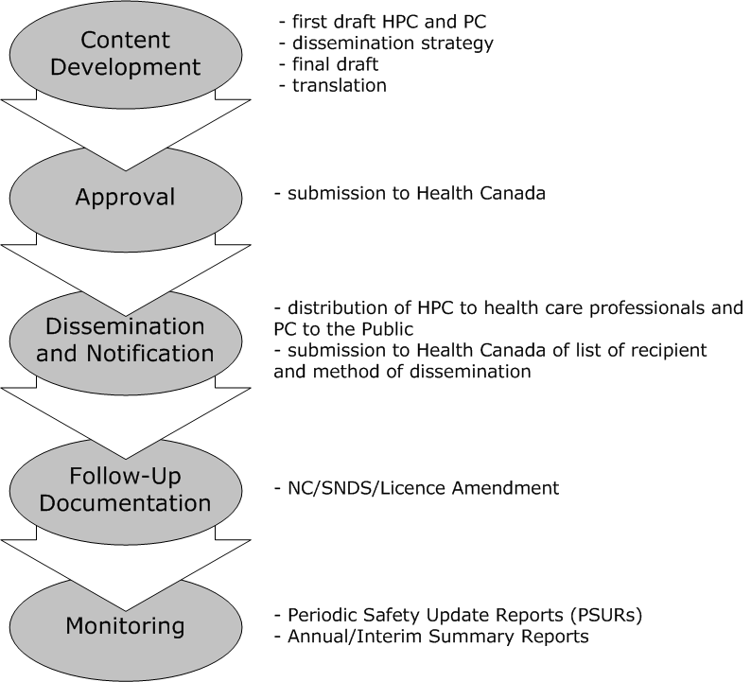
PROCESS FOR HANDLING OF DHCPL Health Canada

Slide 15
Impact of DHCPL
an evaluation of the effectiveness and impact of DHPCLs are performed
to evaluate if they have been received in a timely manner
and if the recommendations and key messages have been understood and followed.

Slide 16
Future status
Increase the speed and spread of dissemination
Postal mail and/or email and/or
Post on MCC and/or applicant and/or others websites:
Professional associations
Journals
Newsletters
CPD points
Impact surveillance

Slide 17
Current status
1. Direct and faster communication ---check mailing vendors have direct email addresses for individual healthcare professionals.
2. Survey -----to assess preference ----- receiving DHCPL ------ post or email or both.
3. Industry’s acceptance ---- DHCPL with the company logo and signatures --- placed on the MCC website.

Slide 18
Thank you for your attention!
benefits >>> risks
greatest achievable margin
the individual patient
population as a whole
benefit
risk
benefit
benefit
benefit
risk
benefit
risk
risk
benefit
risk
benefit

