Slide 1
Tabs used in CTD submissions

Slide 2
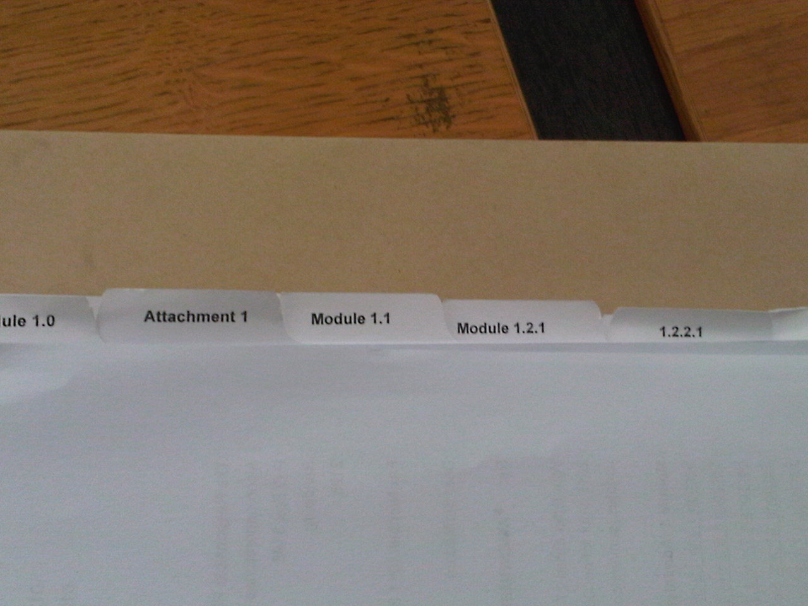
Easy to Navigate

Slide 3
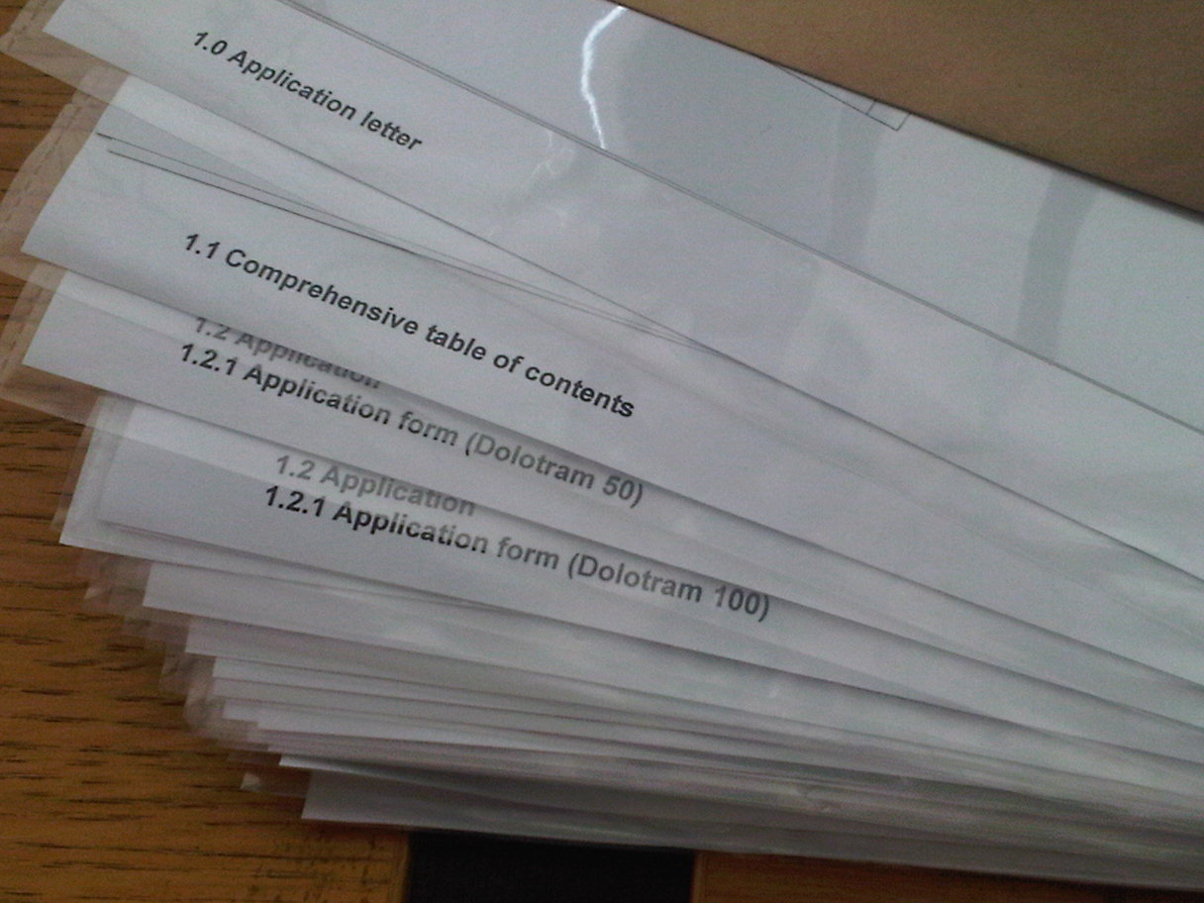
Plastic sleeves …No!

Slide 4
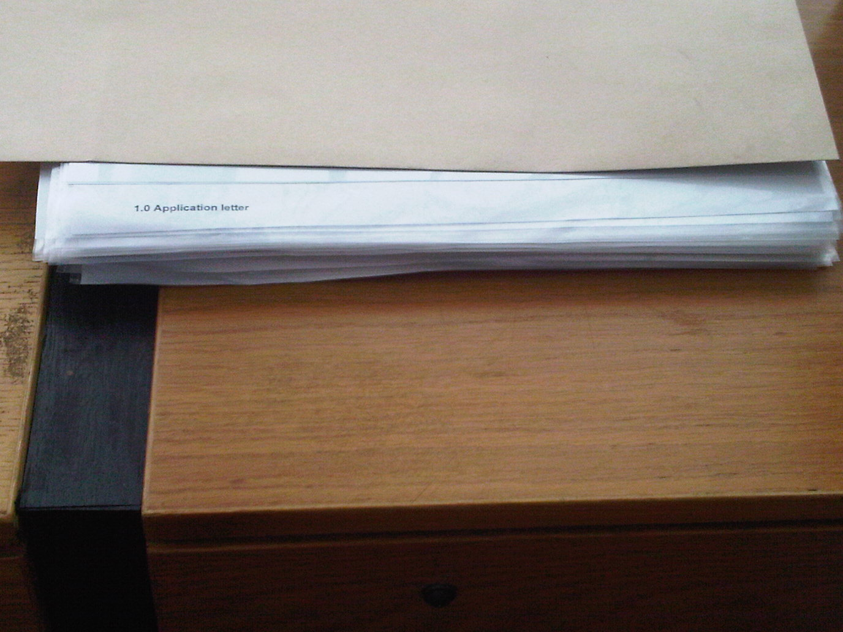
Difficult to Navigate…what’s the point of the new format?

Slide 5
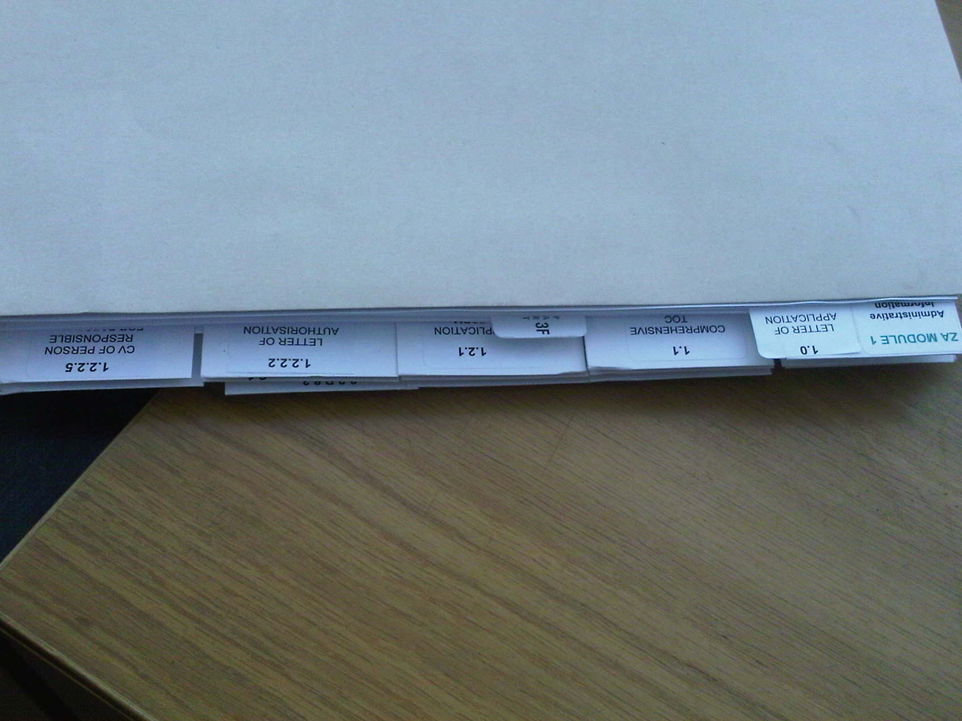
HYBRID Sumission

Slide 6
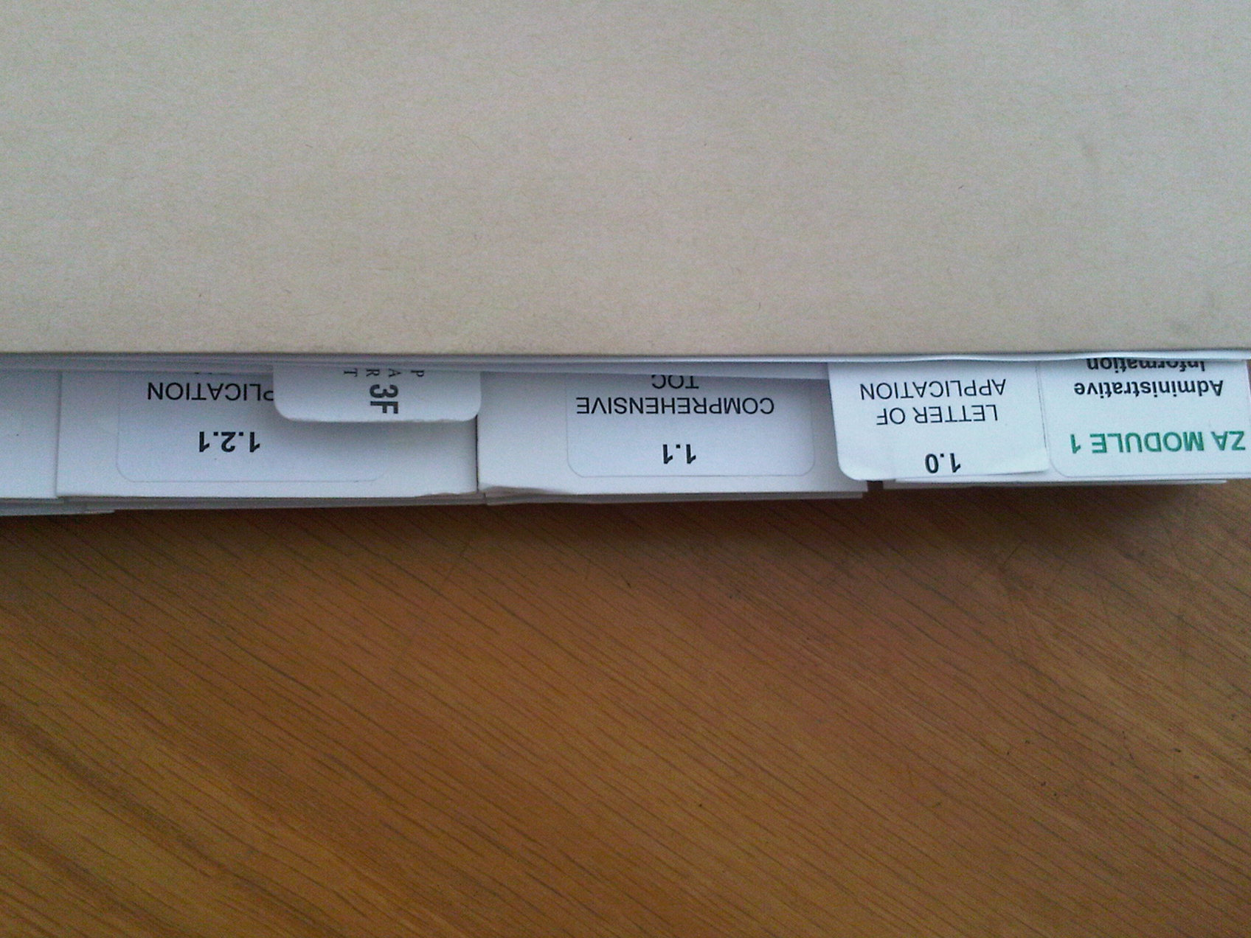
HYBRID SUBMISSIONS ARE REJECTED

Slide 7
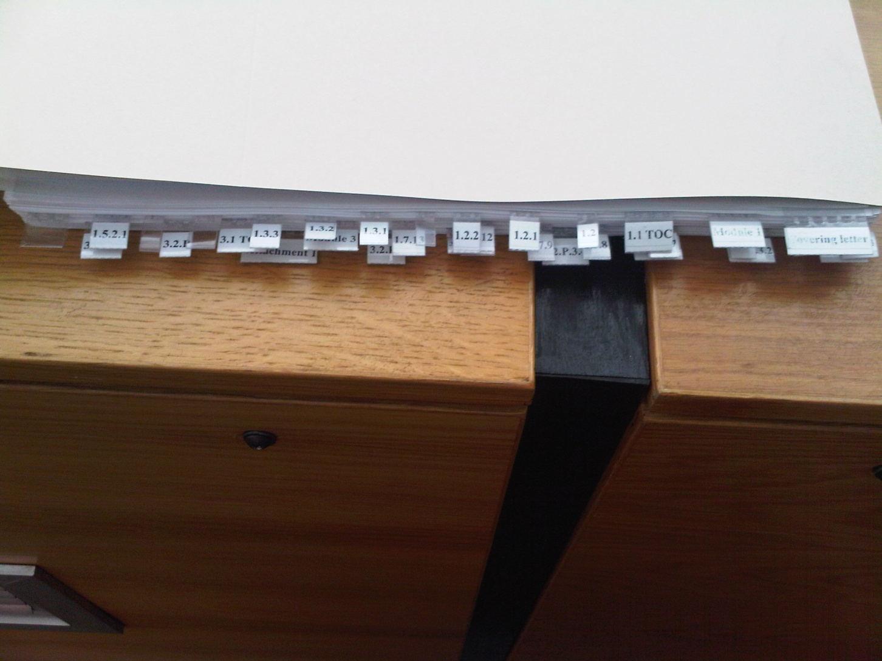
CUT & PASTE TABS

Slide 8
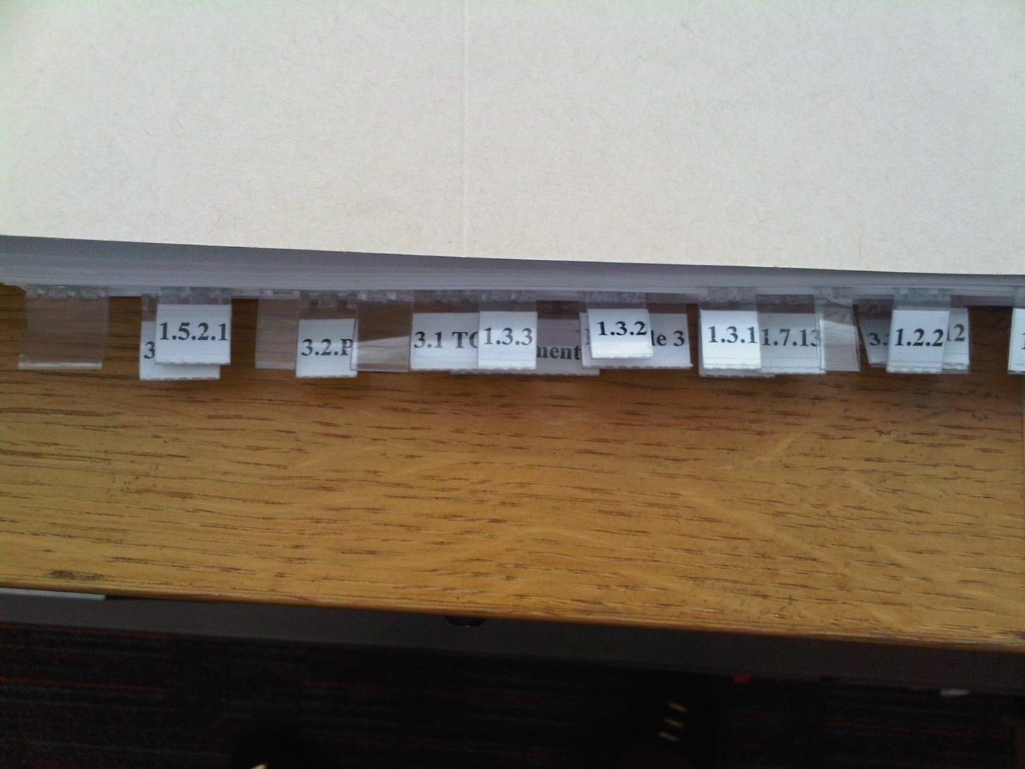
NUMBERS FALL OUT

Slide 9
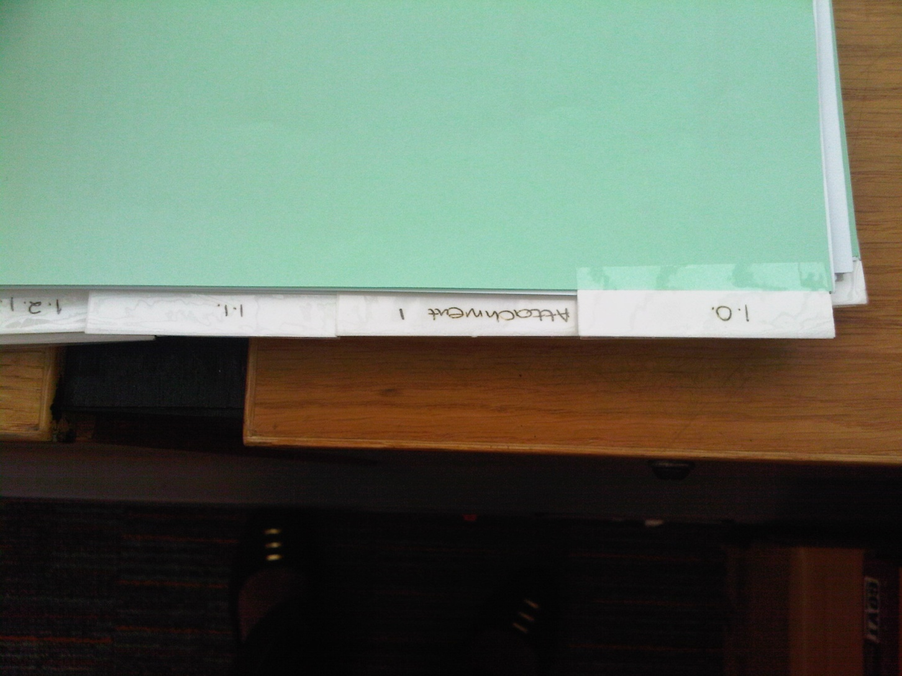
CUT & PASTE , BUT WORKABLE

